Slide 1


ECEN 403 Final Presentation Team 61 HARD William Jachimiak, Jean Jacques Chirat, Preston Bowyer, Aiden George

Slide 2
Problem Overview
Our project seeks to solve the problem of monitoring fall injury prone individuals in assisted-care through the following implementation:
Collection of vertical position & velocity data (minimally invasive) using mmWave radar
Stream the data to ESP32 to be processed by ML detection algorithm
ESP32 communicates positive detection result over WiFi network to Firebase
Firebase interfaces with Android app to notify assisted-care workers if fall event occurs

Slide 3
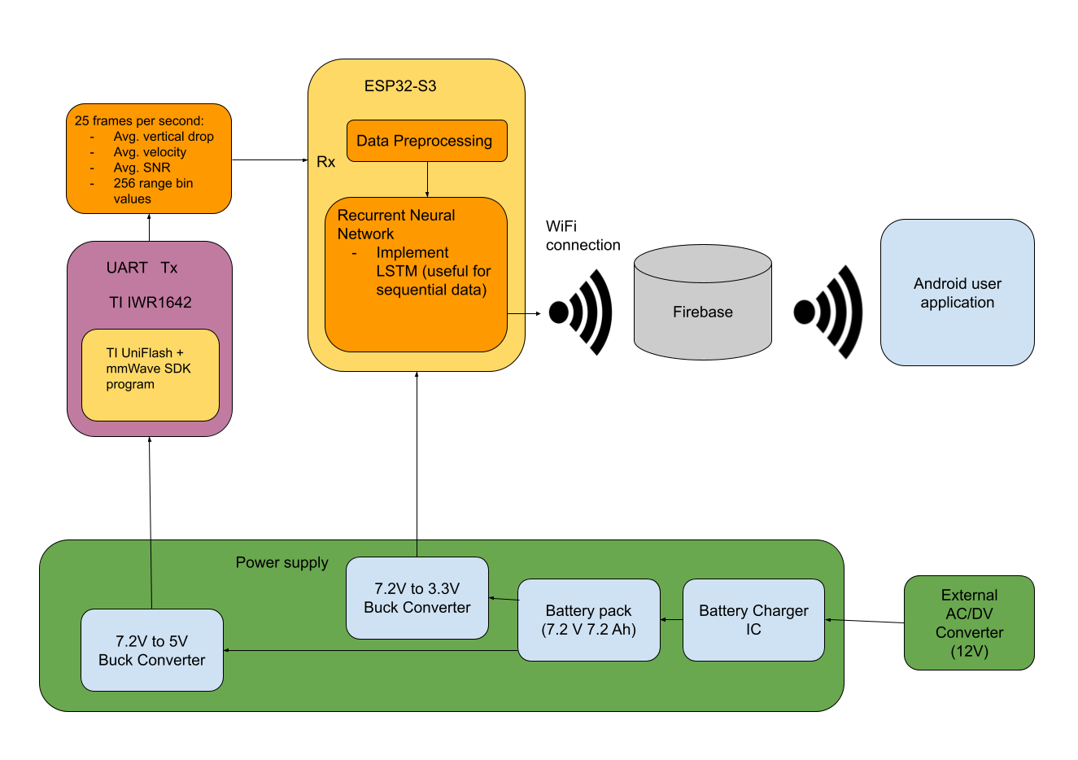
Problem Overview (System Diagram)

Slide 4
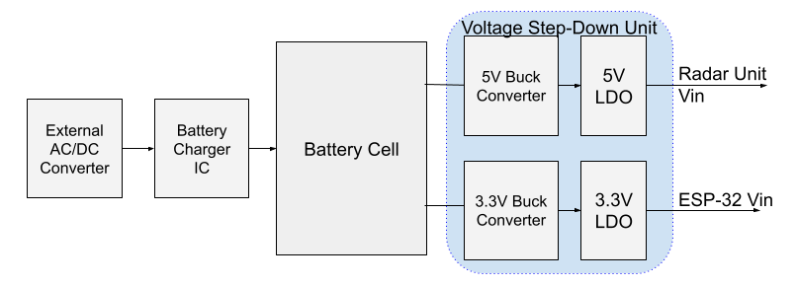
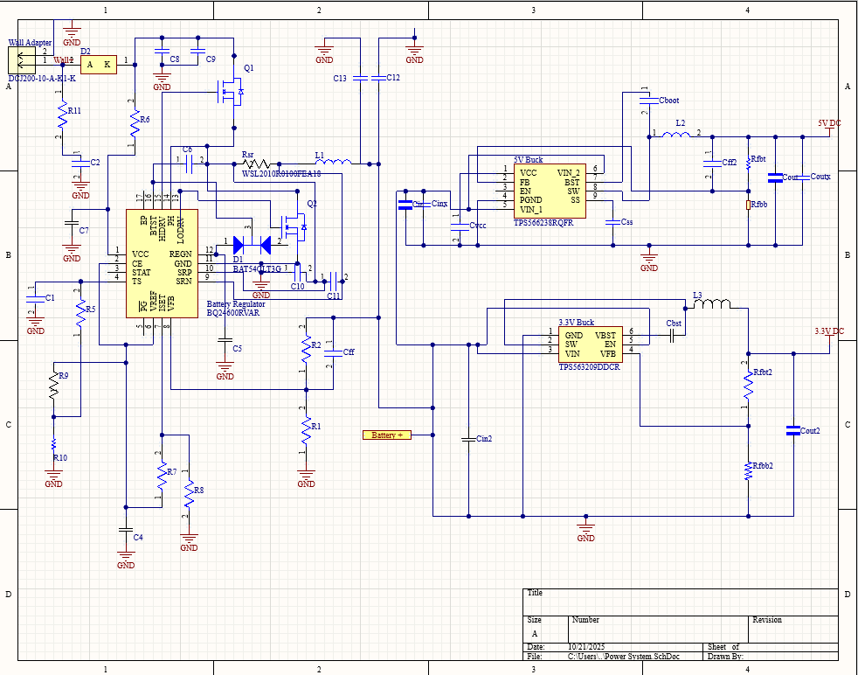
Power System
Provides power both to ESP-32 and Ti Radar Unit using buck converter ICs
Power is stepped down from two Li-Ion 3.6V batteries in series
Battery is charged from a wall mounted 12V AC/DC converted paired with a BQ24600 charging IC to deliver 6A to the battery pack

Slide 5
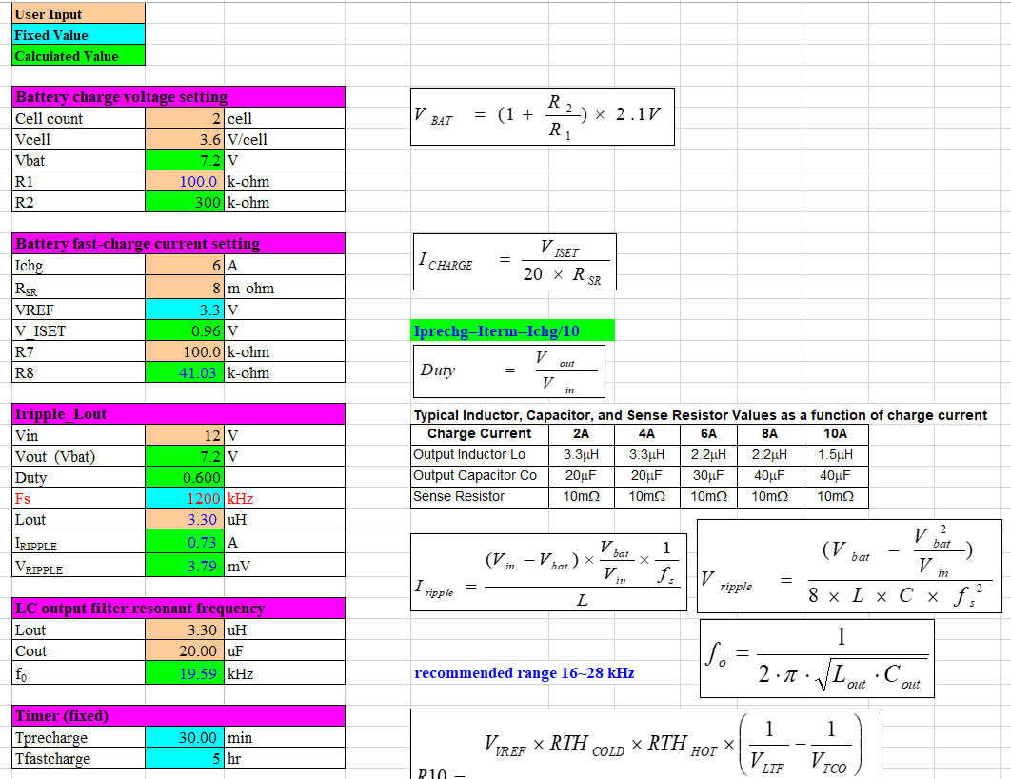
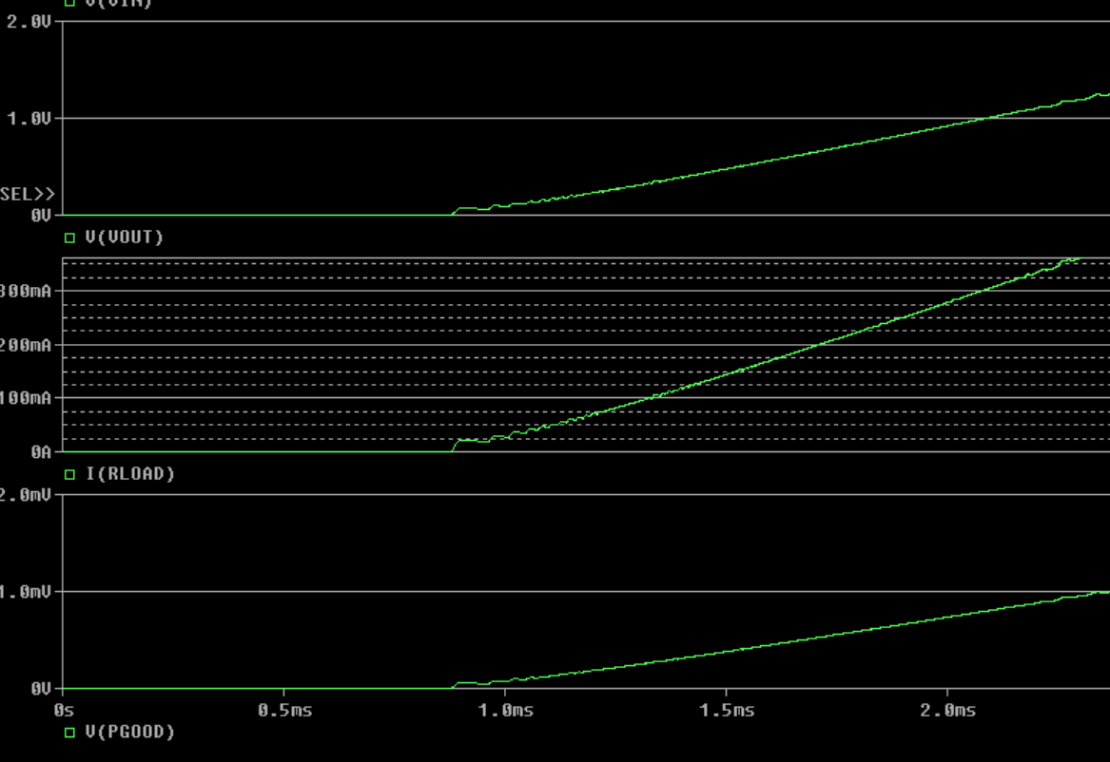
Power Supply
The power system PCB was finalized and ordered, based on design criteria found from Ti Data.
Additional simulation done in PSpice to verify design functionality based on Webench Recommendations
All IC Components have been received, awaiting PCB to begin validation of power system design

Slide 6
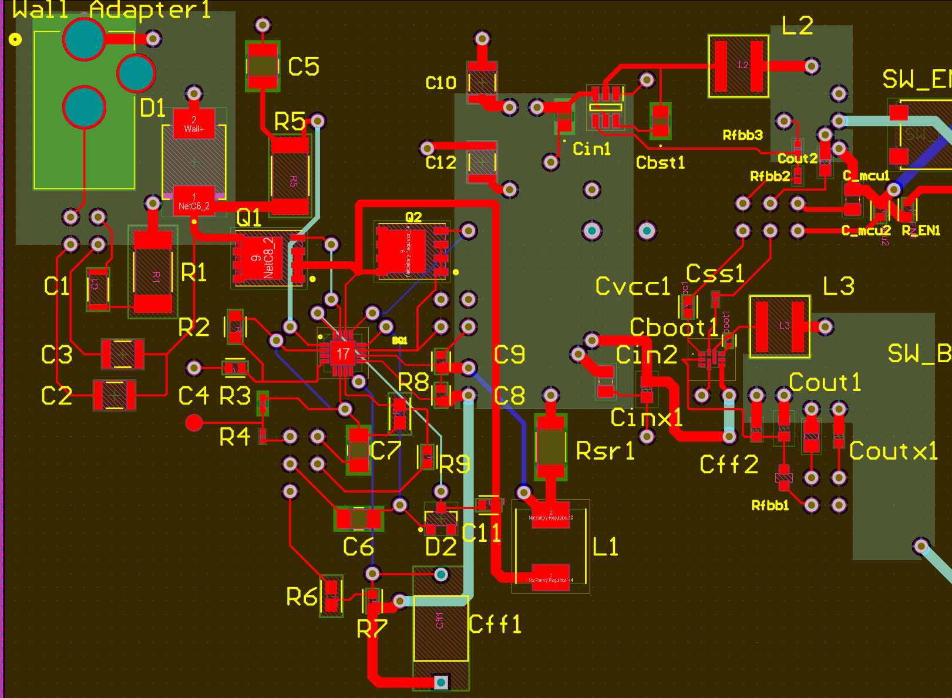
Power Supply PCB

Slide 9
MCU Subsystem
Accomplishments:
Designed the schematic for the MCU in the PCB.
Routed the MCU in the PCB and routed all of the power going to the MCU and the Radar chip.
Connected the MCU to WIFI and set up a system to send out JSON signals.

Slide 10
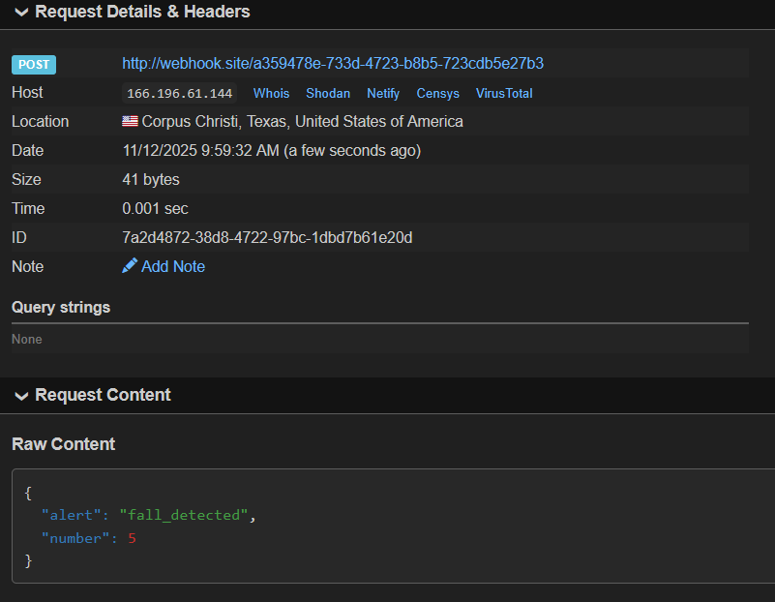
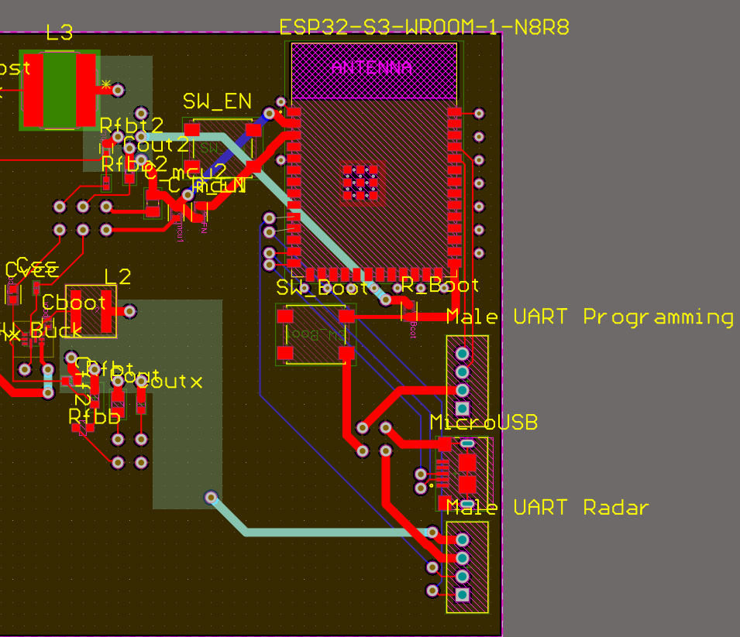
MCU Subsystem

Slide 11
Machine Learning Subsystem
Accomplishments
Implemented the code for preprocessing the raw data output by the radar board
Collected data samples (ongoing) to ensure reliable prediction by model
Produced benchmark accuracy for training the model on larger sets of data in the future

Slide 12
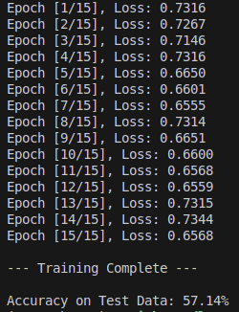
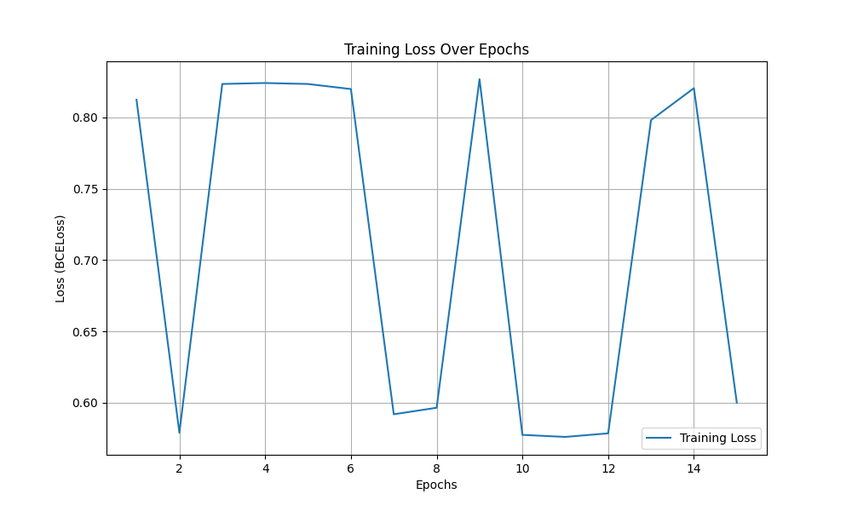
Machine Learning Subsystem
Baseline accuracy for future training
Training loss function over 15 epochs

Slide 13
End User App
Core Functionalities Implemented:
User Authentication:
Secure sign-in and sign-out using Firebase Authentication.
Alert System:
Displays alert cards showing room, time, and alert details, with acknowledgement button that updates the alert status in Firestore.
Cloud Integration:
Alerts stored and retrieved from Firestore, including includes timestamp, status, and acknowledgement tracking.
Push Notifications:
Fully integrated with Firebase Cloud Messaging (FCM).
When an alert is sent from Firebase, a notification banner appears on the device. Tapping the banner opens the corresponding Alert Detail page.
UI/UX:
Clean 3-tab layout: All, Unread, and Acknowledged.
Tested successfully on Android device (Pixel 3a).

Slide 14
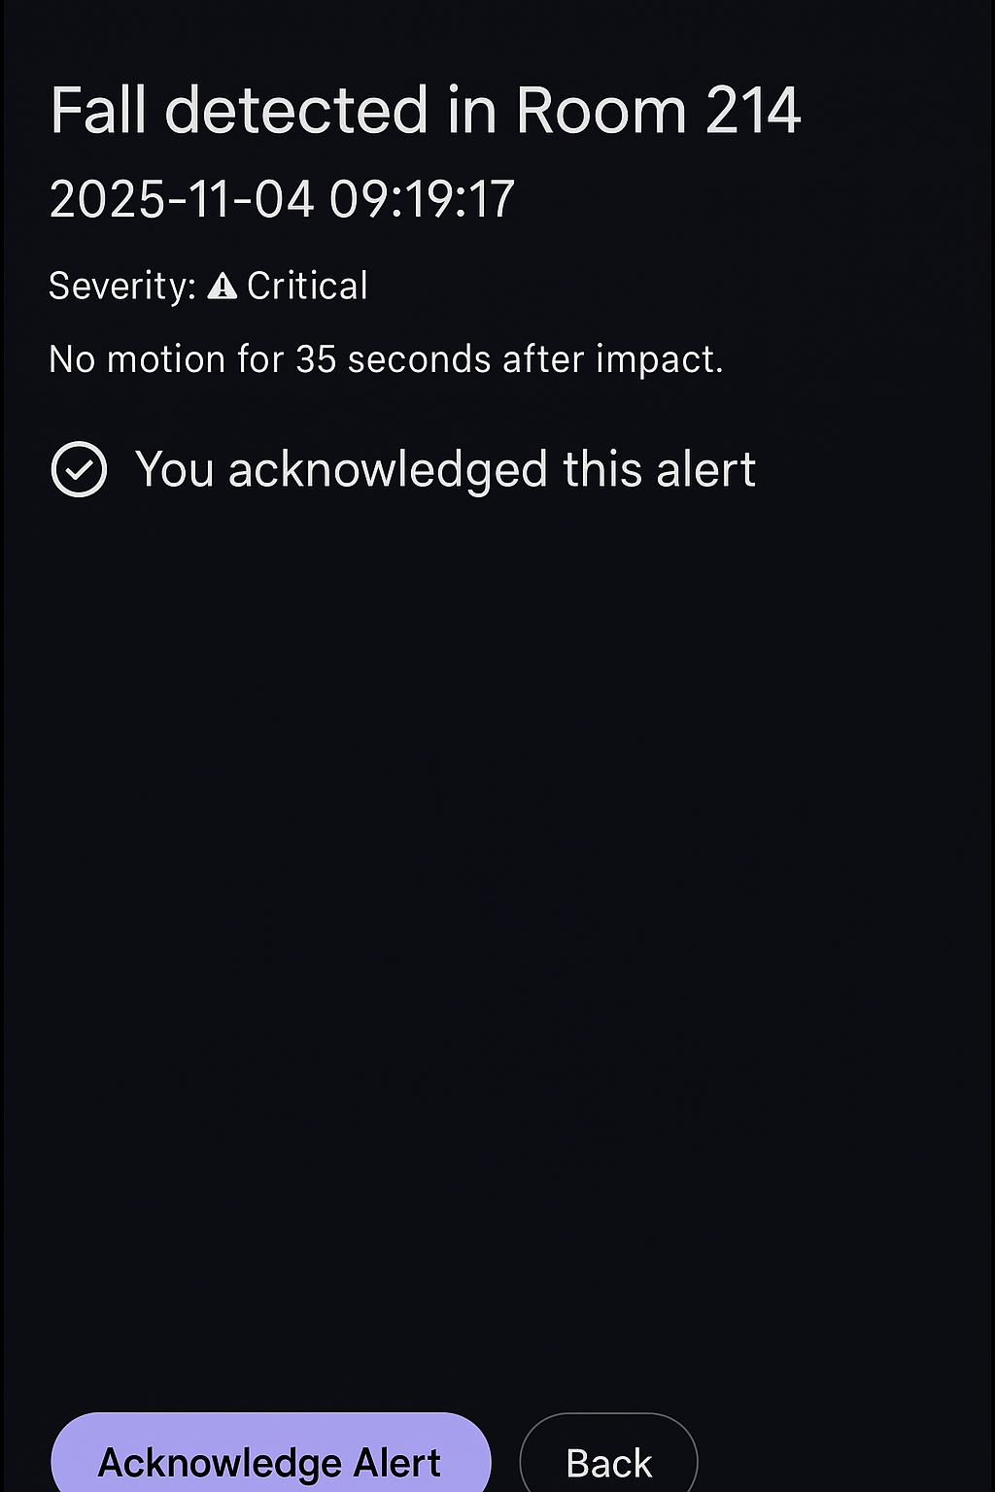
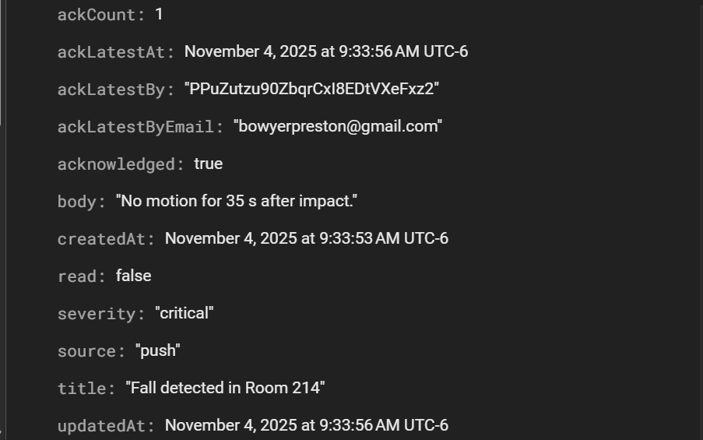
End User App

Slide 15
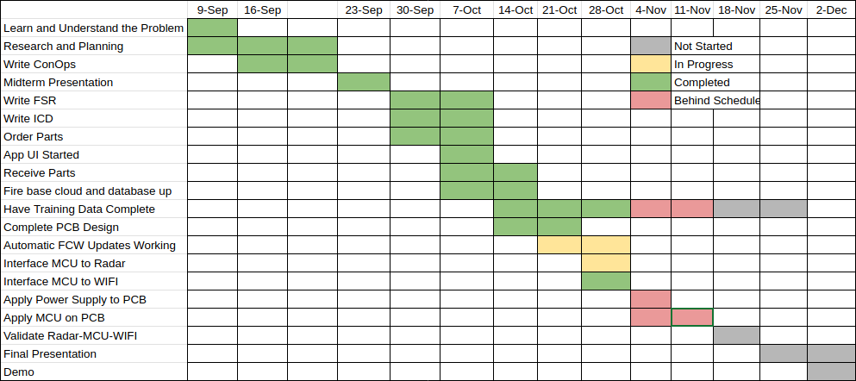
Execution and Validation Status

Slide 16
Validation Plan
Task | Specification | Owner
Peak Power | 10 W | Aiden
Maximum Charger Current | 6A | Aiden
Maximum Battery Life | 10 hr | Aiden
Radar Detect Distance | 8m | All
Detection False Positive Rate | ≤ 10% | JJ/William
Detection False Negative Rate | ≤ 5% | JJ/William
Push Notification delivery success | ≥ 99% | Preston
Multi-device fan-out | ± 300ms spread | Preston
Notification time | ~ 5 seconds | Preston

Slide 17
Remaining Tasks
By Demo:
Demonstrate that power system functions according to simulation behavior
Ensure that ML model can perform basic detection using a limited dataset
Data collection & transmission from radar to MCU
Demonstrate information flow from cloud to app works, in-app functions operate properly, and cloud database stores information accurately
In 404:
Final PCB with the culmination of power and MCU will be fabricated
Continual collection of data until ML model satisfies detection rate
Full integration between MCU, Firebase cloud, and End User App
Design and fabrication of HARD unit radome and mount

